Slide 1
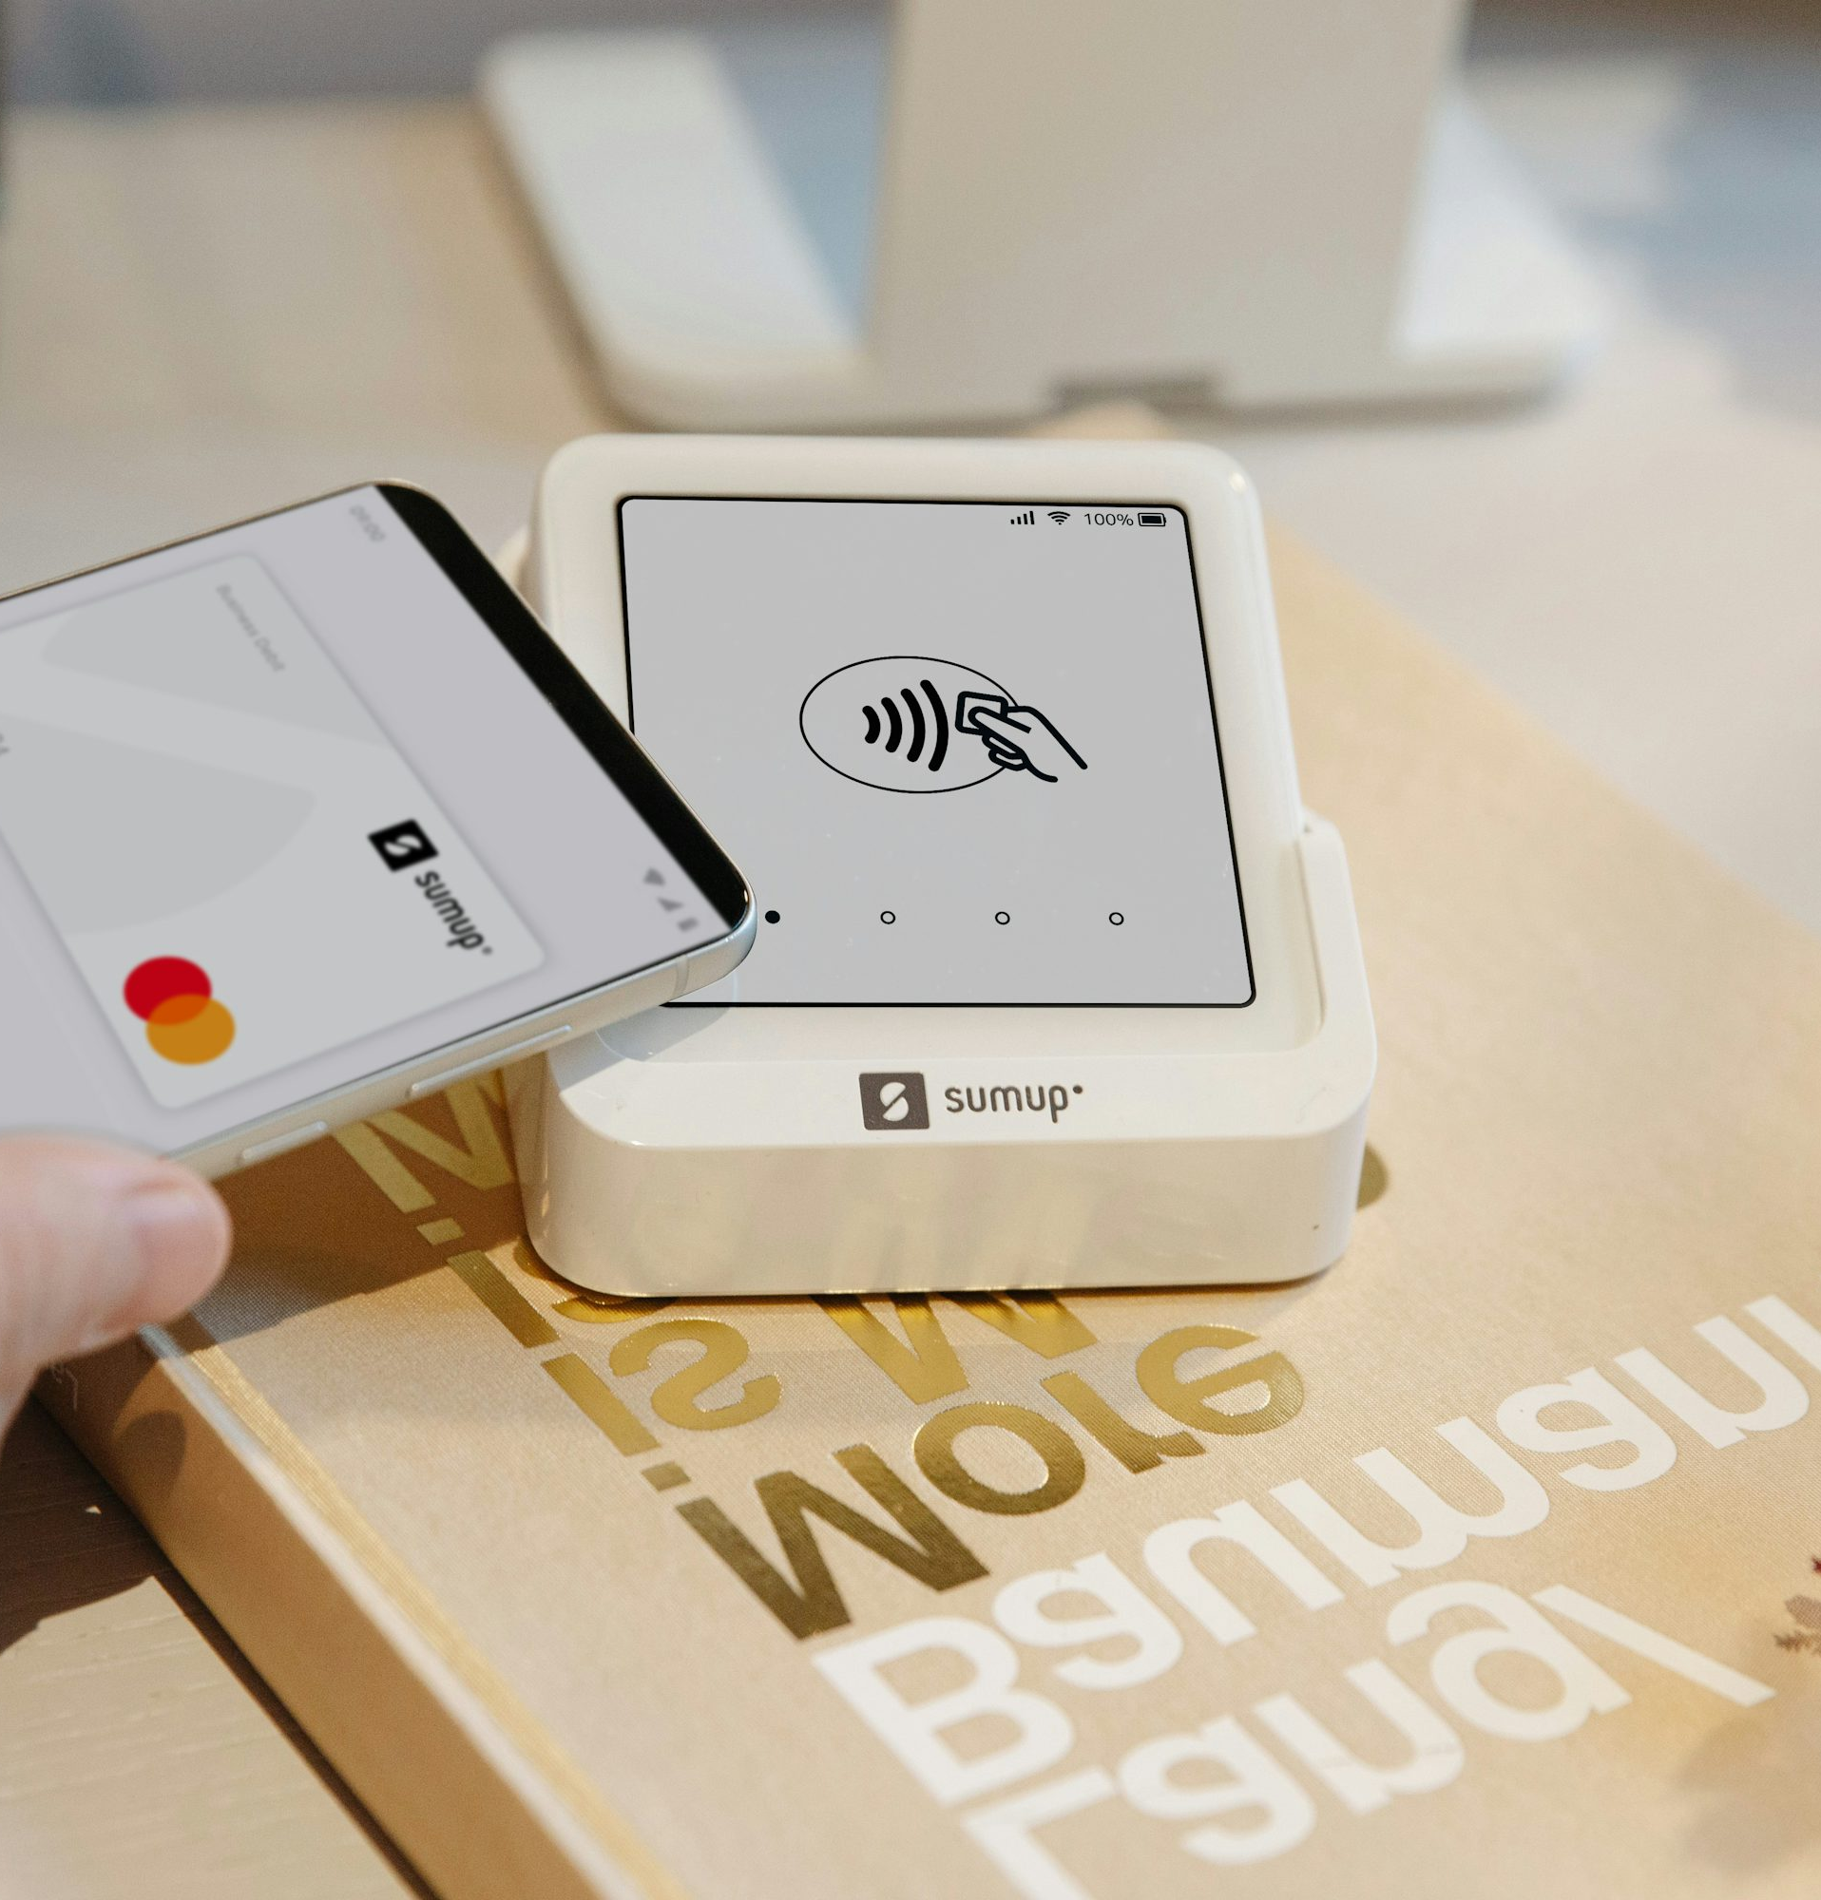
Fintech
FinTech in practice: evolution, business models
& real‑world cases
Payments • Banking • Lending • Crypto • RegTech
1/10

Slide 2
Definition: FINTECH
Fintech = Financial Technology —
-application of technology to improve or automate financial services.
Core Points:
Combines finance + innovation
Reduces cost of services
Improves speed & accessibility

Slide 3
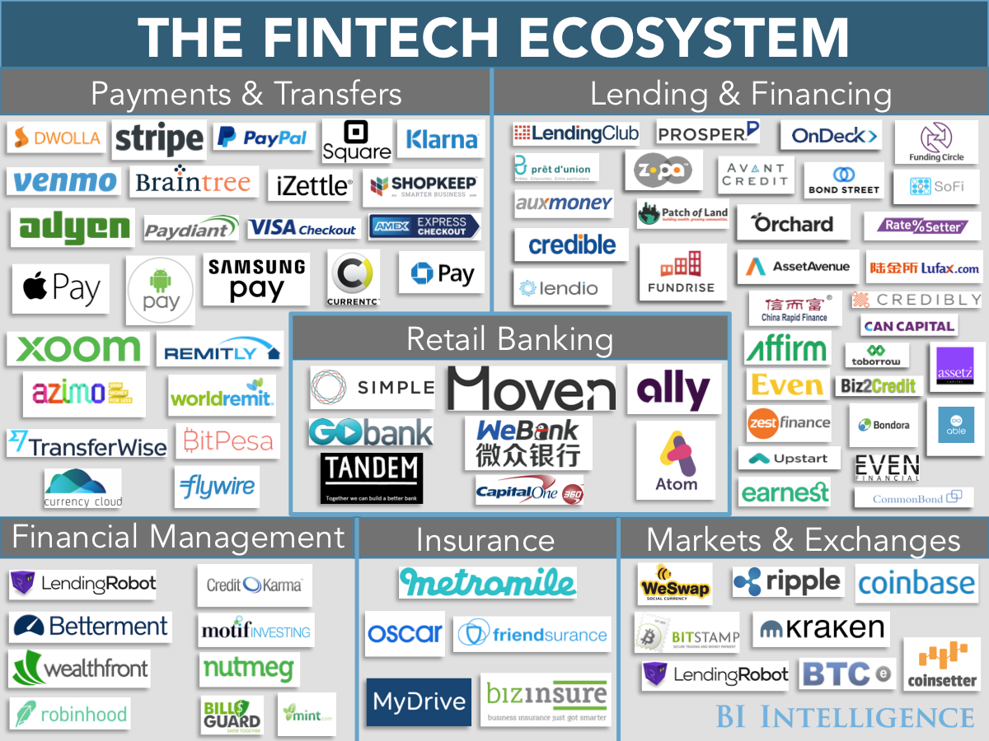
What is FinTech?
A practical definition
“Technology‑enabled innovation in financial services” that changes products, processes, or business models.
Key drivers
Smartphones + always‑on connectivity
Cloud + APIs (faster product iteration)
Data + AI (personalisation, fraud}
NOTE: it’s not “startups vs banks” — it’s a stack of new capabilities.
2/10
Notes:
[

Slide 4
Evolution: from charge cards to embedded finance
Key milestones that shaped modern FinTech
1950
1995
Diners Club
charge card
Internet
banking
2020s
1967
2007
First ATM
(Barclays)
Smartphones
+ M‑Pesa
AI & embedded finance
Pattern: new rails (cards/ATMs) → digital channels (internet/mobile) → platform models (APIs) → data‑sharing + embedded finance.
3/10

Slide 5
Why Fintech Matters
Benefits
Faster transactions
Increased financial inclusion
Lower fees
Innovative user experience
Challenges
Cybersecurity risks

Slide 6

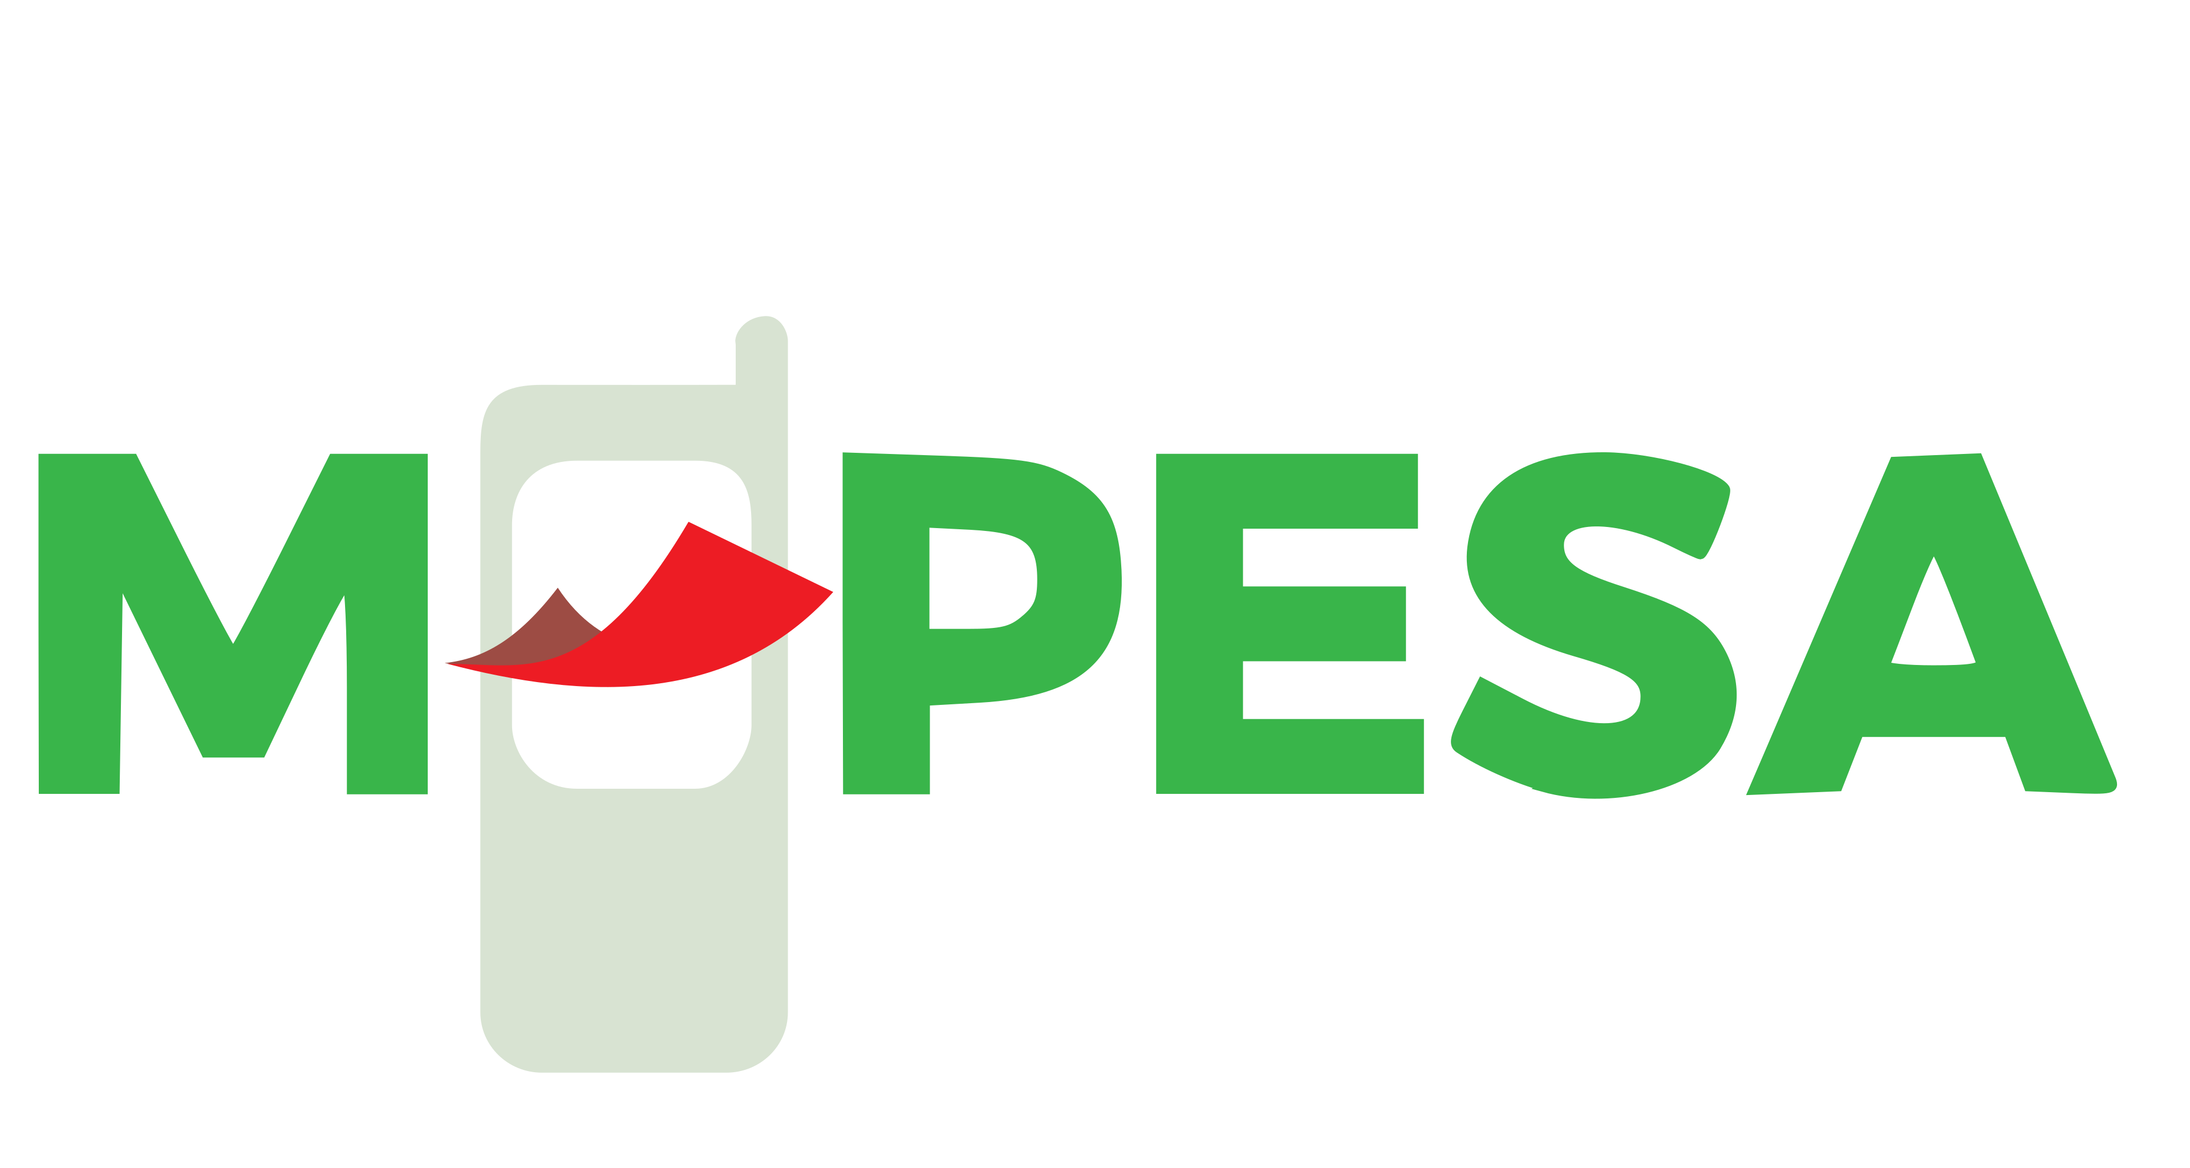
Case 1 — Payments: Stripe + M‑Pesa
Two different “rails”, both reshaping money movement
Stripe (payments infrastructure)
M‑Pesa (mobile money)
Developer‑first APIs: integrate cards, wallets and bank transfers.
Platform pattern: payments + billing + fraud
Makes “moving money” a reusable software component.
Cash‑in/cash‑out agent network: bridges physical cash to digital value.
Transfers, bill payments, merchant payments — even on basic phones.
A canonical “inclusion” FinTech model in emerging markets.
Note:— once money moves digitally, other services can be layered on top.
4/10
Notes:
[Sources] - https://stripe.com/ (Stripe overview) - https://en.wikipedia.org/wiki/Stripe,_Inc. (Stripe founded 2010; APIs for payment processing) - https://commons.wikimedia.org/wiki/File:Stripe_Logo,_revised_2016.svg (logo) - https://www.vodafone.com/news/newsroom/digital-society/m-pesa-created (M‑Pesa launch) - https://commons.wikimedia.org/wiki/File:M-PESA_LOGO-01.svg (logo) [/Sources]

Slide 7

Case 2 —Revolut
Mobile‑first distribution, multi‑product monetisation
Revolut (Europe/UK‑led super‑app pattern)
FX + cards + subscriptions → cross‑sell into savings, investing, crypto, loans.
Scale lever: app distribution + automated onboarding/KYC.
Illustrates “banking as a product”, not just a charter.
2025 – Annual Report 68.3M customers worldwide. Revenue increases by 46% Valued at $750m, USD Operating as a bank in 30+ markets
Discussion: Where do these banks make money — interchange, subscriptions, FX, lending spreads, or “everything everywhere”?
5/10

Slide 8


Case 3 — BNPL: Afterpay + Klarna
Credit at checkout: convenience, fees, and regulation
Afterpay (Australia‑born BNPL)
Klarna (early BNPL → broader commerce platform)
Four‑instalment model: consumer adoption via “simple + fast” UX.
Revenue often driven by merchant fees (and late fees where allowed).
Scaled distribution through retailer checkout integration.
BNPL grew from online checkout to marketing + shopping discovery.
Credit risk + consumer outcomes drive regulatory attention.
Industry signal: acquired by Block (deal completed 2022).
Founded 2005 (Stockholm) — one of the earliest large BNPL players.
Watch‑outs: credit losses in downturns, merchant concentration, and tighter consumer‑credit regulation.
6/10

Slide 9

Crypto- new risks
Where does it fit in the FinTech landscape?
What to understand
Crypto uses smart contracts to offer trading, lending, and other services without traditional intermediaries.
Stablecoins + exchanges often connect crypto markets to the real economy (“on/off‑ramps”).
Coinbase as an example of an exchange
Risk checklist
Volatility and liquidity shocks
Governance risks
Regulatory and consumer‑protection gaps
7/10

Slide 10

What’s next?
Trends to watch (and the risks that come with them)
Trends
Embedded finance (payments/lending inside non‑bank products)
Real‑time payments + instant settlement expectations
AI everywhere: fraud, service, underwriting, personal finance coaching
Digital identity + wallets + tokenisation experiments
System risks & controls
Cybersecurity + data protection
Model risk (AI): bias, drift, explainability
Concentration (a few cloud/API providers)
Operational resilience + incident response
AI + data: big upside, but governance matters.
9/10

Slide 11
Conclusion
Key takeaways
Cases covered
FinTech is a set of capabilities (APIs, data, UX, automation) that can be adopted by any institution.
Most success stories start with a wedge product, then expand via cross‑sell and platform effects.
Regulation and trust are not “constraints” — they are part of the product.
Risk management (fraud, cyber, credit, model risk) is a competitive advantage.
10/10

